Slide 1
Measuring Internal Product Attributes Size
Chapter 8

Slide 2
Software Size
Internal product attributes describe a software product in a way that is dependent only on the product itself.
One of the most useful attributes is the size of a software product, which can be measured statically, i.e., without executing the system.
It is necessary to define software size in terms of more than one internal attributes, each capturing a key aspect of software size.
Size measurement must reflect effort, cost and productivity.

Slide 3
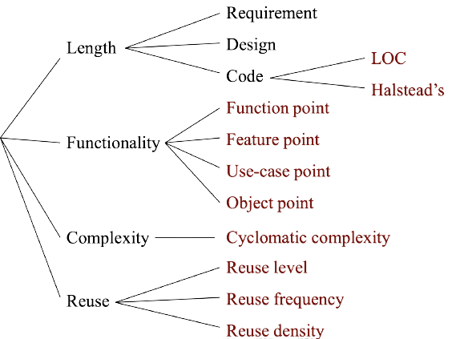
Software Size Metrics
Software size

Slide 4
Software Size
Software size can be described by length, functionality, and complexity.
Length is the physical product size.
Functionality is a measure of the functions supplied by the product to the user.
Complexity is a multi-faceted attribute which can be interpreted in multiple ways.
Reuse is also an issue in size, specifically the amount or size of reuse within a program.

Slide 5
Software Size: Length
Length is the “physical size” of the product.
In a software development effort, there are three major development products: specification, design, and code.
The length of the specification can indicate how long the design is likely to be, which in turn is a predictor of code length.

Slide 6
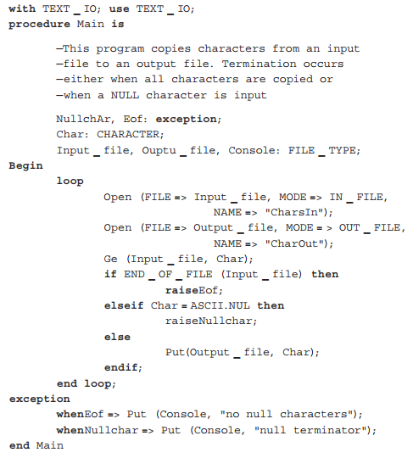
Software Size: Length

Slide 7
Software Size: Length
Variations of LOC:
Count of physical lines including blank lines.
Count of all lines except blank lines and comments.
Count of all statements except comments (statements taking more than one line count as only one line).
Count of all lines except blank lines, comments, declarations and headings.
Count of only executable statements, not including exception conditions.

Slide 8
Software Size: Length
The most commonly used measure of source code program length is the number of lines of code (LOC).
NCLOC: non-commented source line of code or effective lines of code (ELOC).
CLOC: commented source line of code.
By measuring NCLOC and CLOC separately we can define:
total length (LOC) = NCLOC + CLOC
the density of comments in a program : CLOC/LOC

Slide 9


Software Size: Length
Advantages of LOC
Simple and automatically measurable
Correlates with programming effort (& cost)
Disadvantage of LOC
Vague definition
Language dependability
Not available for early planning
Developers’ skill dependability
Encouraging “sumo” development!

Slide 10
Software Size: Length (Halstead’s work)
Maurice Halstead’s Theory (1971~1979): A program P is a collection of tokens, composed of two basic elements: operands and operators
Operands are variables, constants
Operators are defined operations in a programming language
a, b, arr[], x, 5
If…else,main, for, switch…
Notes:
https://www.geeksforgeeks.org/software-engineering-halsteads-software-metrics/

Slide 11
Halstead’s work
Number of distinct operators in the program (μ1)
Number of distinct operands in the program (μ2)
Total number of occurrences of operators in the program (N1)
Total number of occurrences of operands in the program (N2)
Program vocabulary (μ)
μ = μ₁ + μ₂
Program length is the total number of occurrences of operators and operands:
N = N₁ + N₂
Program volume is the number of mental comparisons needed to write a program of length N, bits or space required to store the program.

Slide 12
Example
#include <stdio.h>
main(){
int a;
scanf(“%d”, &a);
if(a >= 10)
if(a < 20)
printf(“10 < a < 20 %d\n”, a);
else
printf(“a >= 20 %d\n”, a);
else printf(“a <= 10 %d\n”, a);
}

Slide 13
Example
#include <stdio.h>
main(){
int a;
scanf(“%d”, &a);
if(a >= 10)
if(a < 20)
printf(“10 < a < 20 %d\n”, a);
else
printf(“a >= 20 %d\n”, a);
else printf(“a <= 10 %d\n”, a);
}
Operators | Number of occurrences | Operators | Number of occurrences
# | 1 | <= | 1
include | 1 | \n | 3
stdio.h | 1 | printf | 3
< … > | 1 | < | 3
main | 1 | >= | 2
( … ) | 7 | if … else | 2
{ … } | 1 | & | 1
int | 1 | , | 4
; | 5 | %d | 4
scanf | 1 | “ … “ | 4
μ₁ = 20 |  | N₁ = 47

Slide 14
Example
#include <stdio.h>
main(){
int a;
scanf(“%d”, &a);
if(a >= 10)
if(a < 20)
printf(“10 < a < 20 %d\n”, a);
else
printf(“a >= 20 %d\n”, a);
else printf(“a <= 10 %d\n”, a);
}
Operands | Number of occurrences
a | 10
10 | 3
20 | 3
μ₂ = 3 | N₂ = 16
μ₁ = 20 | N₁ = 47
Program Vocabulary μ = μ₁ + μ₂ = 23
Program length: N = N₁ + N₂ = 63
Program Volume: V = Nlog₂μ = 63 log2 23 = 284.98

Slide 15
Halstead’s work
Program vocabulary (μ) μ = μ₁ + μ₂
Program Length N = N1 + N2
Estimated program length N^ = μ₁log₂μ₁ + μ₂log₂μ₂
Program Level: To rank the programming languages, the level of abstraction provided by the programming language, program level (L) is considered. The higher the level of a language, the less effort it takes to develop a program using that language.
L = V* / V = (2/μ₁) * (μ₂/N₂)
where V* is the minimum potential volume. Ranges of L is between zero and one.
Minimum Potential Volume: the volume of the most succinct program in which a problem can be coded.
Notes:
https://www.geeksforgeeks.org/software-engineering-halsteads-software-metrics/
n1* = Number of potential operators.
n2* = Number of potential operands.
V* = (2 + n2*) * log2(2 + n2*)
C language, any program must contain at least the definition of the function main()), possibly as a function or as a procedure: n1* = 2, since at least 2 operators must appear for any function or procedure : 1 for the name of the function and 1 to serve as an assignment or grouping symbol, and n2* represents the number of parameters, without repetition, which would need to be passed on to the function or the procedure.

Slide 16
Halstead’s work
Program Difficulty (D): measures how difficult to handle a program D = 1/L
As the volume of the implementation of a program increases, the program level decreases and the difficulty increases.
Program Effort: Measures the amount of mental activity needed to translate the existing algorithm into implementation in the specified programming language.
E = V / L = D * V = Difficulty * Volume
Notes:
https://www.geeksforgeeks.org/software-engineering-halsteads-software-metrics/

Slide 17
Halstead’s work
Program Time: Measures the amount of time needed to translate the existing algorithm into implementation in the specified programming language.
T = E / β
In cognitive psychology β is usually a number between 5 and 20. Halstead claims that β=18
Remaining Bug: the number of bugs left in the software at the delivery time
B = E^{2/3}/3000
Conclusion: the bigger program needs more time to be developed and more bugs remained
Notes:
https://www.geeksforgeeks.org/software-engineering-halsteads-software-metrics/

Slide 18
Example 2
For the following program calculate Halstead’s (c1) number of operators; (c2) number of operands; (c3) program vocabulary; (c4) occurrences of operators in the program; (c5) occurrences of operands in the program; (c6) program length; (c7) program volume; (c8) program estimated length.
1: read x,y,z;
2: type = “scalene”;
3: if (x == y or x == z or y == z) type =“isosceles”;
4: if (x == y and x == z) type =“equilateral”;
5: if (x >= y+z or y >= x+z or z >= x+y) type =“not a triangle”;
6: if (x <= 0 or y <= 0 or z <= 0) type =“bad inputs”;
7: print type;

Slide 19
Example 2
1: read x,y,z;
2: type = “scalene”;
3: if (x == y or x == z or y == z) type =“isosceles”;
4: if (x == y and x == z) type =“equilateral”;
5: if (x >= y+z or y >= x+z or z >= x+y) type =“not a triangle”;
6: if (x <= 0 or y <= 0 or z <= 0) type =“bad inputs”;
7: print type;
Operators |  |  |  | Operands
read | 1 | == | 5 | strings | 5
, | 2 | or | 6 | x | 9
; | 7 | and | 1 | y | 8
“...” | 6 | >= | 3 | z | 8
= | 5 | <= | 3 | 0 | 3
if | 4 | + | 3 | type | 6
() | 4 | print | 1
μ1 = 14
N1 = 51
μ2 = 6
N2 = 39

Slide 20
Example 2
(c1) Number of distinct operators in the program: μ1 = 14
(c2) Number of distinct operands in the program: μ2 = 6
(c3) Program vocabulary: μ = μ1 + μ2 = 20
(c4) Total number of occurrences of operators in the program: N1 = 51
(c5) Total number of occurrences of operands in the program: N2 = 39
(c6) Program length: N = N1 + N2 = 90
(c7) Program volume: V = N log2 μ = 90 log2 (20) = 388.9735
(c8) Program estimated length: N^ = μ1 log2 μ1 + μ2 log2 μ2
= 14 log2 14 + 6 log2 6
= 68.81274

Slide 21
Critics of Halstead’s work
Critics of Halstead’s work Developed in the context of assembly languages and too fine grained for modern programming languages.
The treatment of basic and derived measures is somehow confusing.
The notions of time to develop is arguable.
Unable to be extended to include the size for specification and design.

Slide 22
Length: Alternative Methods
Alternative methods for text-based measurement of code length:
Source memory size: Measuring length in terms of number of bytes of computer storage required for the program text. Excludes library code.
Char size: Measuring length in terms of number of characters (CHAR) in program text.
Object memory size: Measuring length in terms of an object (executable or binary) file. Includes library code.
All are relatively easy to measure (or estimate).

Slide 23
Measure Properties of Software Size
Three properties for any valid measure of software size:
Nonnegativity: All systems have nonnegative size.
Null value: The size of a system with no elements is zero.
Additivity: The size of the union of two modules is the sum of sizes of the two modules after subtracting the size of the intersection

Slide 24
Length: Code – Problems
One of the problems with text-based definition of length is that the line of code measurement is increasingly less meaningful as software development turns to more automated tools, such as:
Tools that generate code from specifications
Visual programming tools
What can be the length measure for objects that are not textual?
How can one account for components that are constructed externally? (library, repository, inherited functions, design patterns, etc.)
Notes:
https://en.wikipedia.org/wiki/Comparison_of_code_generation_tools

Slide 25
Length: Code – Problems
The LOC size measurement needs to be replaced by some other size measures, such as:
Object points (as used in COCOMO 2.0), etc.
Measuring length by taking into account the reused portion of code.

Slide 26
Length: Spec. & Design
Specification and design documents are usually composed of logical text (axioms, constraints, etc.) and diagrams (flow graphs, etc.) Define atomic objects to measure textual contents and graphical contents, e.g.,
Diagram | Atomic objects
Data-flow diagram | bubbles
Data dictionary | Data element
Entity-relationship diagram | Objects, relations
State transition diagrams | States, transitions

Slide 27
Length: Prediction
Theoretically, size of design can be used to predict size of code.
Each project has a design-to-code expansion ratio.
If design is measured by the number of modules of size S_{i} , then:
LOC = σ ∑S_{i}
σ is the design-to-code expansion ratio recorded for previous similar projects.

